Slide 1
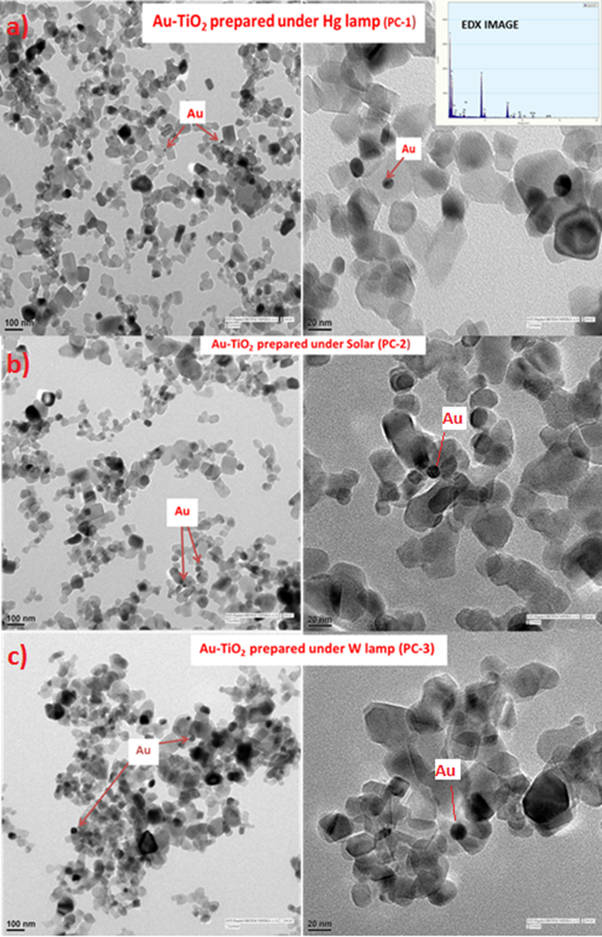
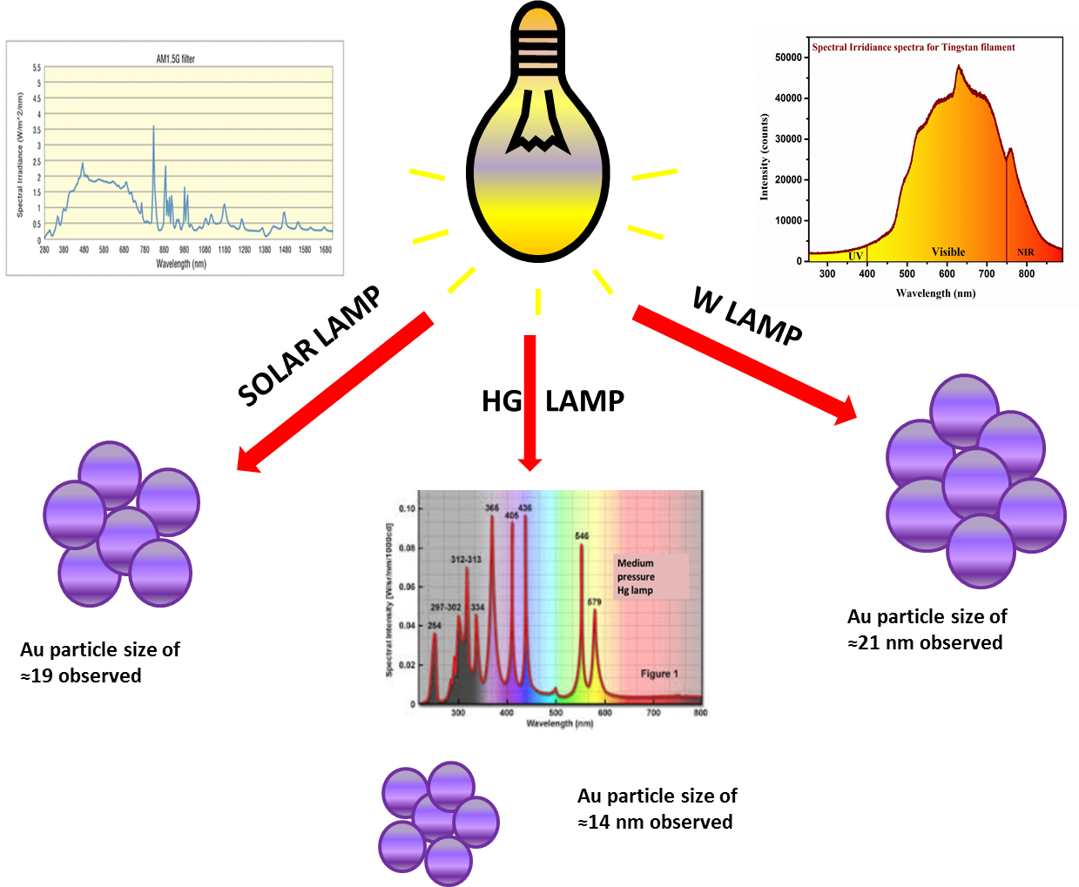
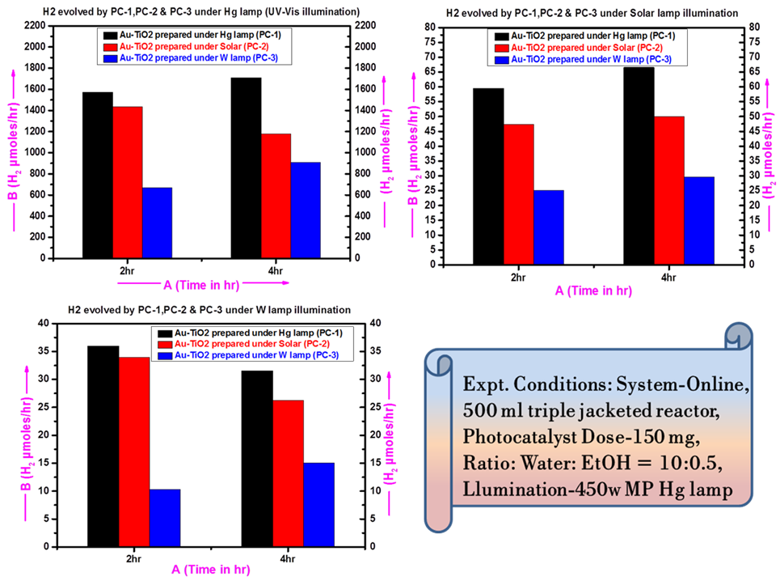
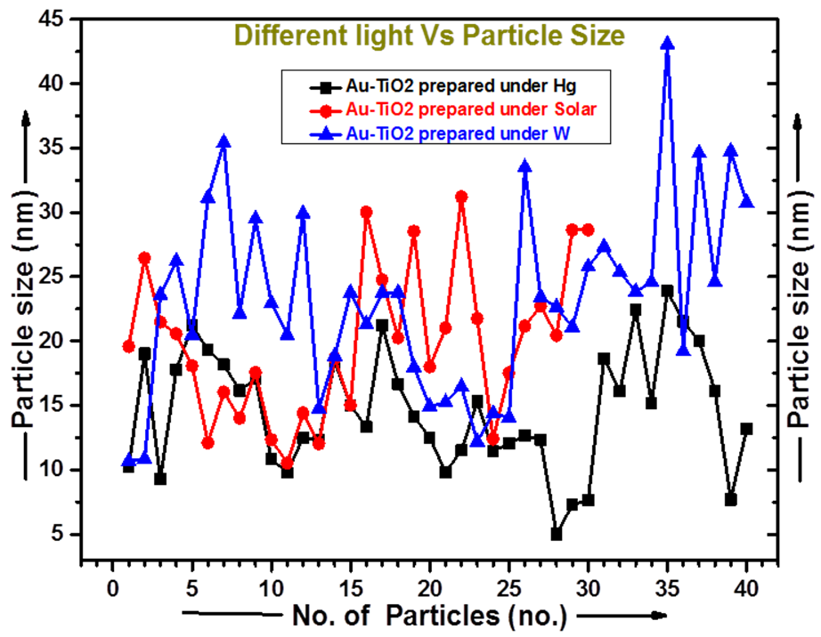
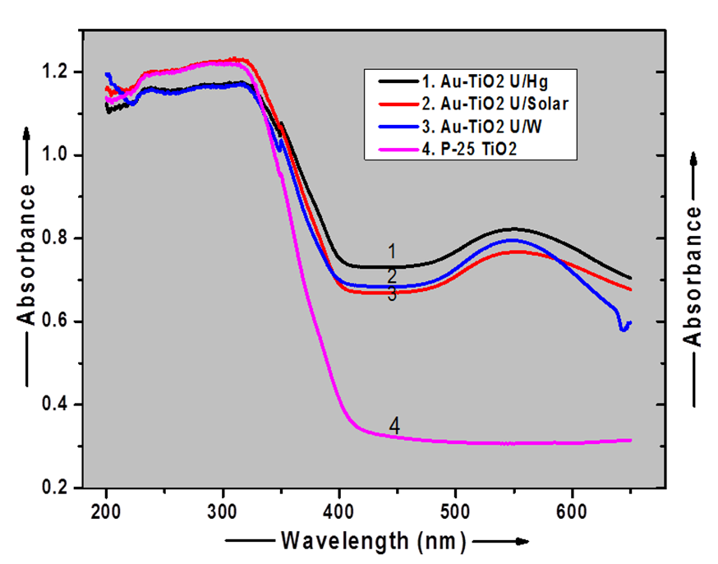
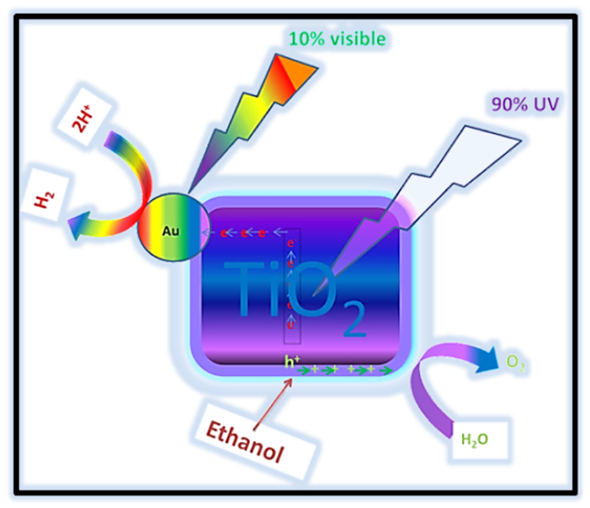
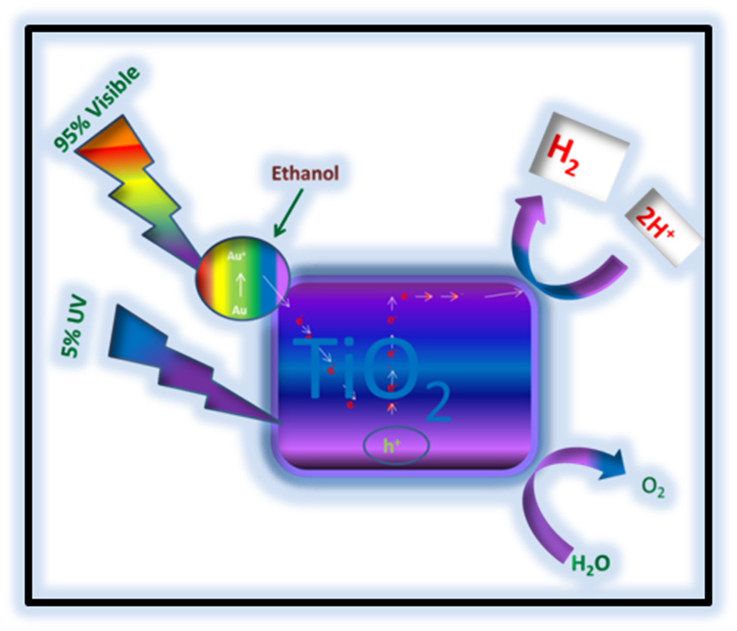
Titania Gold composite: Effect of Illumination on size of gold nanoparticles with consequent implication on photocatalytic water splitting Girivyankatesh Hippargi, Pratap Reddy Maddigapu, Nitin Labhsetwar & Sadhana Rayalu CSIR-NEERI, Nagpur, E-mail: gk_hippargi@neeri.res.in, s_rayalu@neeri.res.in
Abstracts
This work deals with the study of photodeposition (PD) of gold nanoparticles (AuNPs) on TiO₂ by using different illumination sources, Medium pressure Mercury lamp (ML), Solar Simulator equipped with AM 1.5 (SL) & Tungsten lamp (WL). Different particle size of AuNPs on TiO₂ were obtained by photodeposition method under different illumination sources, which clearly proves the influence of light source on the synthesis of Au-TiO₂. The plasmonic activity of Au-TiO₂ photocatalyst for water splitting reaction was observed to be strongly influenced by the particle size of Au as well as illumination source. Amongst the three different illumination sources used, smallest particle size for AuNP-TiO₂ were observed under ML followed by SL and WL, as revealed by TEM analysis. Different illumination sources were also investigated to evaluate the activity of Au-TiO₂ samples thus prepared under different illumination conditions. The order of hydrogen evolution rate (HER) observed for Au-TiO₂ with different source of illuminations is ML > SL > WL. The highest HER of 1709 µmol/h was observed for Au-TiO₂, which was synthesized and evaluated under ML irradiation. This may be explained on the basis of reduced catalytic activity and photothermal effect of Au nanoparticles with increasing particle size.
Performance of Au-TiO2 Photocatalyst prepared under different illumination conditions
The prepared Au-TiO2 photocatalysts having different average particle size of Au ≈14 nm (PC-1), ≈19 nm (PC-2) & ≈21 nm (PC-3) under three different illuminations were employed to study their consequence impact on the photocatalytic activity for water splitting reaction. These photocatalysts were evaluated for photocatalytic hydrogen generation under three 400w illumination sources a) medium pressure mercury lamp b) solar simulator with AM 1.5 and 3) tungsten lamp.
Amongst three photocatalysts, Au-TiO2 having average Au particle size of ≈14 nm (range ≈5 to 23 nm) is showing best photocatalytic performance in all the three illumination sources, possibly due to the smaller Au nanoparticles as compared to others. The size of Au nanoparticles and illumination source appears to play significant role in the presence of all the three illumination conditions. The surface plasmon resonance (SPR) property showed by Au particles increases the optical properties of Au nanoparticles such as optical absorption and optical scattering. These properties largely dependent on the size of nanoparticles. Bigger the AuNPs size, more the optical scattering, thus photothermal effect will also be decreased with decrease in the light absorption. The results are in covenant with respect to the outcome of UV-DRS and TEM results.
This can be attributed to –
i) Subwavelength metallic particles function as effective light harvesting agents, which absorb optical radiation due to the surface Plasmon (collective oscillations of delocalized conduction electrons) and
ii) Metal NPs on absorption of light are excited and some energy is remitted through scattering of light and some energy is dissipated through Landau (nonradiative) damping with significant increase in temperature on the surface of the particles thus facilitating photothermal catalysis.
.
Materials Characterization & study
TEM photographs, Fig.1 (a, b, c) suggest that, Au is present in the form of nano particles and appears as dark spherical structures dispersed on the surface of TiO₂. Particle size comparison chart Different light Vs particle size shows that, the AuNPs of PC-1, PC-2 & PC-3 are in the size range of ≈5 to 23 (Average ≈14 nm), ≈10 to 30 (Average ≈ 19nm) and ≈11 to 43 (Average ≈ 22nm) respectively. Out of three photocatalysts investigated, Au-NPs prepared by ML irradiation are the smallest in size and have good particle size distribution which could be due to the higher photon energy associated with more percent of UV radiations present in ML spectrum, thus efficiently reducing the Au ions on TiO₂ surface
Fig 3 Different size of AuNPs with respect
to the illumination sources.
Fig.5 HER rate observed using three different photocatalyst prepared
under three different illumination source
Fig.1 (a, b, c) TEM photographs
Photocatalytic water splitting reaction mechanism
AuNPs enhances the photocatalytic activity not only due to their role as a co-catalyst, but also due to the plasmonic effect exhibited by them. It is well observed that under different illumination source it shows the different energy transfer mechanism. The interaction with electromagnetic light forms two types of electromagnetic transitions, one interband transitions and other intraband transitions [36,37].
Fig.2 Particle size comparison chart
Fig 4 UV-DRS spectrum of three photocatalyst
Effect of illumination source on photodeposition of AuNPs on TiO₂
Three different light sources were employed to understand the effect of light illumination over the synthesis of AuNPs on surface of TiO₂ using photodeposition method. The smallest particle size range of ≈5 to 23 nm (average ≈ 14) was achieved with ML lamp, which is attributed to the high photon energy supplied by the UV spectrum, followed by ≈10 to 30 nm (average≈19) & ≈11 to 43 nm (average≈21) for SL & WL lamp respectively. Fig 3 shows graphical representation of different size of gold nanoparticles prepared with respect to the illumination sources. The results elucidate that UV radiation facilitates high nucleation rate than the growth of AuNPs on TiO₂, hence smaller size of AuNPs obtained using ML radiation source compared to SL and WL radiation sources. These results obtained using different light sources indicates that photocatalysts synthesized by photodeposition route is a light dependent phenomenon. Among ML, SL and WL illumination sources used lower wavelength radiation percentage decreases in the trend ML > SL > WL. The results are consistent with the finding of DRS (Fig.4) and TEM analysis explained in
Fig. 6 Mechanism of photocatalytic water splitting under UV and visible wavelengths
Conclusion
The average Au particle size of ≈14 nm was obtained with high photon energy supply of UV-Vis rich source i.e medium pressure mercury lamp which appears to be best for synthesis of Au-TiO2, than the solar lamp and tungsten lamp illumination source. The significant enhancement in the photoactivity of medium pressure mercury lamp (ML) induced Au-TiO2 photocatalyst is attributed to the smaller AuNPs having pronounced photocatalytic and photothermal properties. Thus it is apparent that photodeposition using medium pressure mercury lamp (ML) illumination source is a promising approach to synthesize such photocatalysts, while more importantly the size of nanoparticles and related photocatalytic properties can be tailored using this simple technique.
The financial support of CSIR Networking project NWP-56 (TAP-SUN) is highly acknowledged

